Slide 1


OPTIMATCH
JOB PLACEMENT WEBSITE
Shatha Althbiti
Mosab Alsagabi
Norah Alsomali
Nujud Albaqshi

Slide 2





INTRODUCTION
Matching
WHAT IS OPTIMATCH?
OptiMatch is a job placement website that supports the official career center for over 750 universities worldwide using a matching tool connecting students and companies.
As an analysts team, we want to analyze the OptiMatch funnel for the product team to enhance student job placement, so that we can improve and provide better opportunities for students.

Slide 3

HOW DOES IT WORK?
RECRUITERS
JOB PLACEMENT
Listing job offers
Students expressing interest and being approved
STUDENTS
ALGORITHM
Looking for jobs
Selecting up to 20 candidates per job offer

Slide 4


HYPOTHESES
1
Opt-In Rate Impact:
The ease of opting into the system directly affects the opt-in rate.
2
Profile Completeness and Engagement Impact:
Students with complete profiles, including uploaded resumes and active engagement with job offers, are more likely to receive job placement opportunities.

Slide 5

3
HYPOTHESIS
Shortlisting Process Optimization:
Analyzing and optimizing the shortlisting process directly impacts job placement outcomes.

Slide 6

4
HYPOTHESIS
The Impact of Having a Career Center:
Educational institutions with career centers positively affect the shortlisting process.

Slide 7
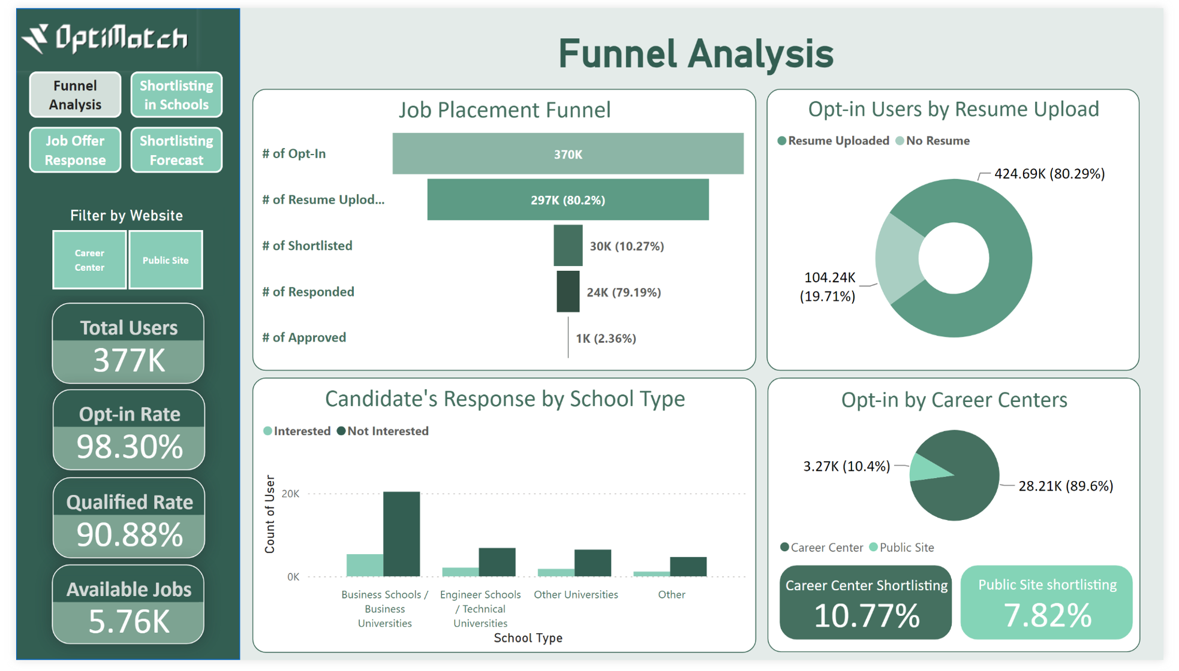

Slide 8
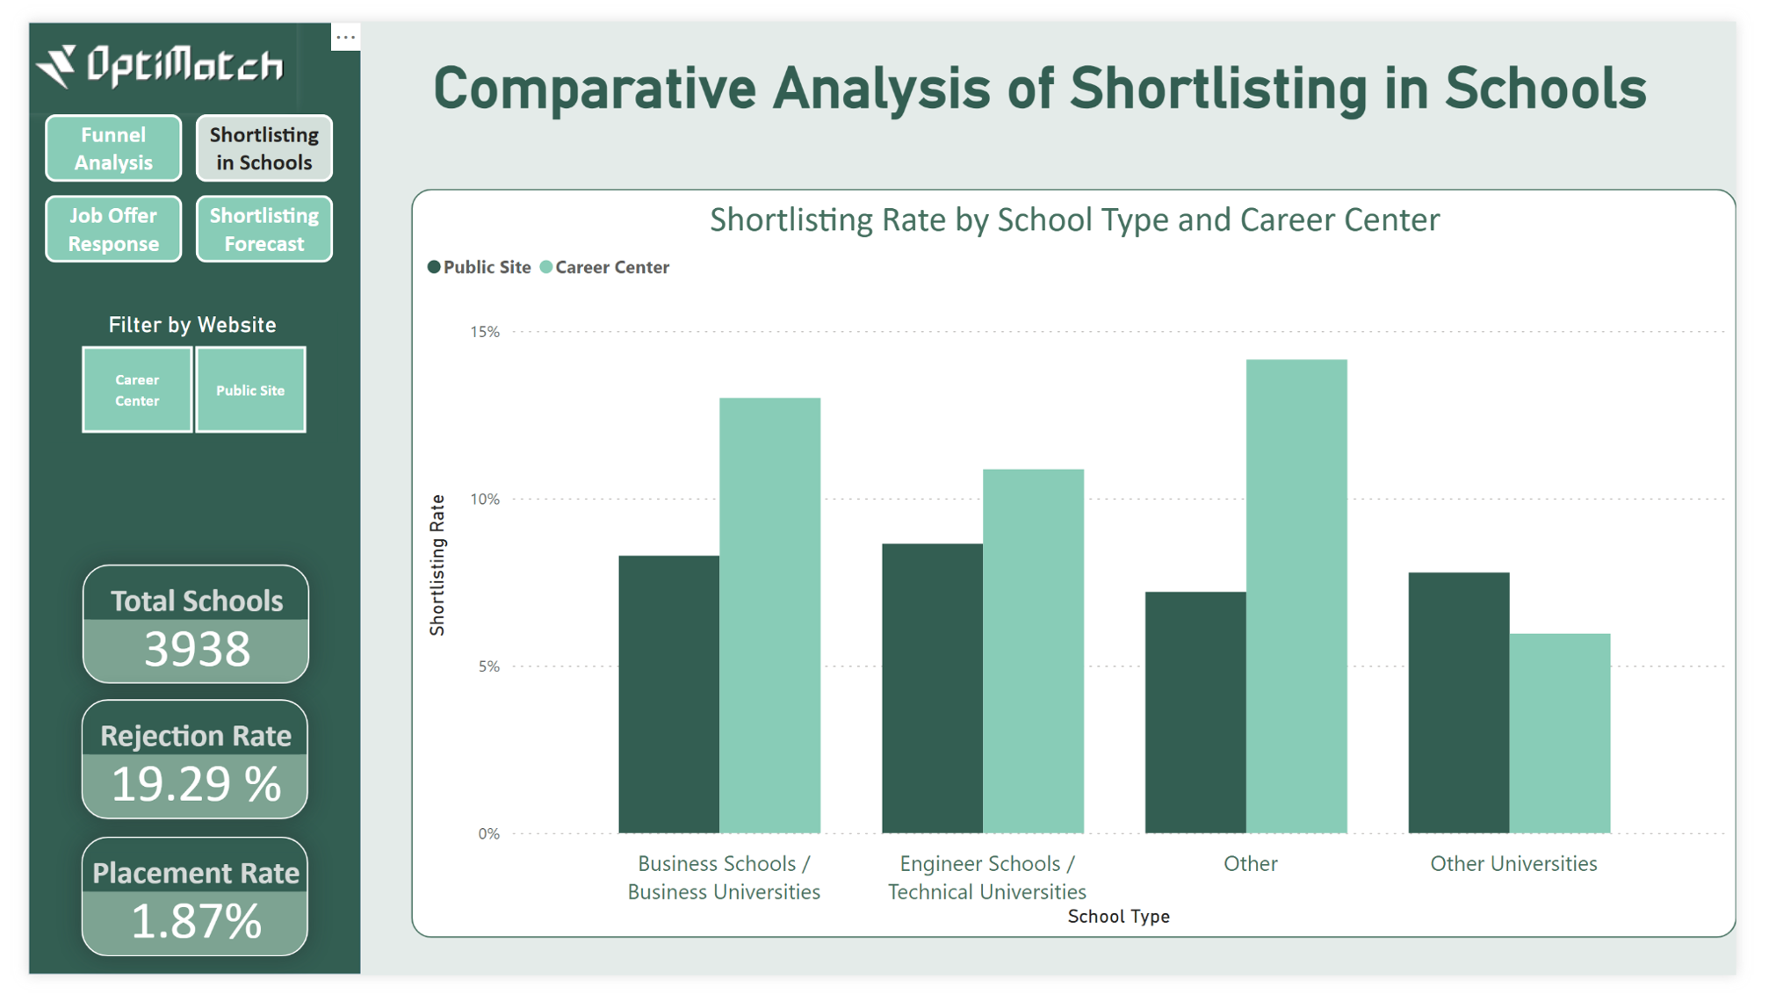

Slide 9
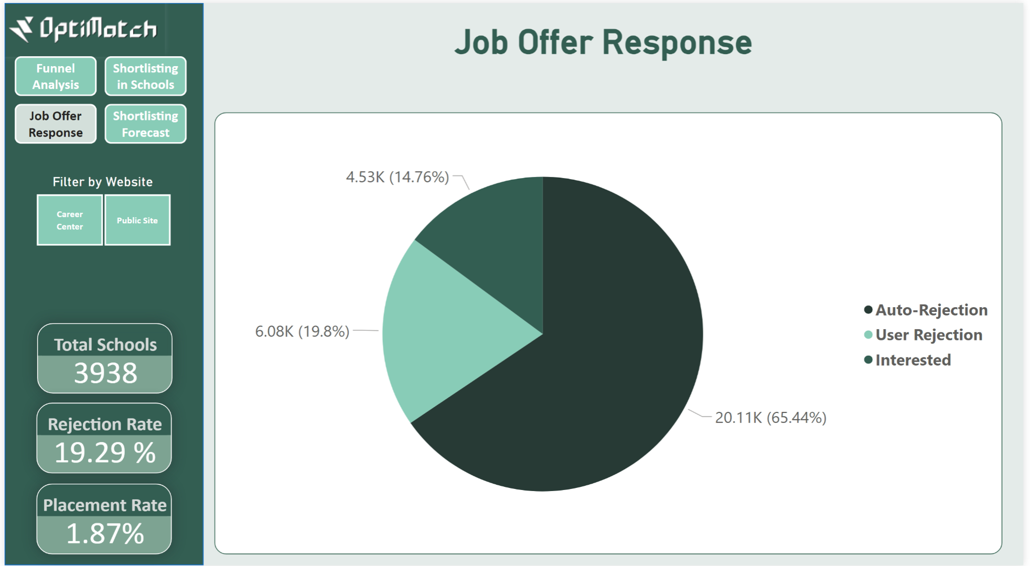

Slide 10
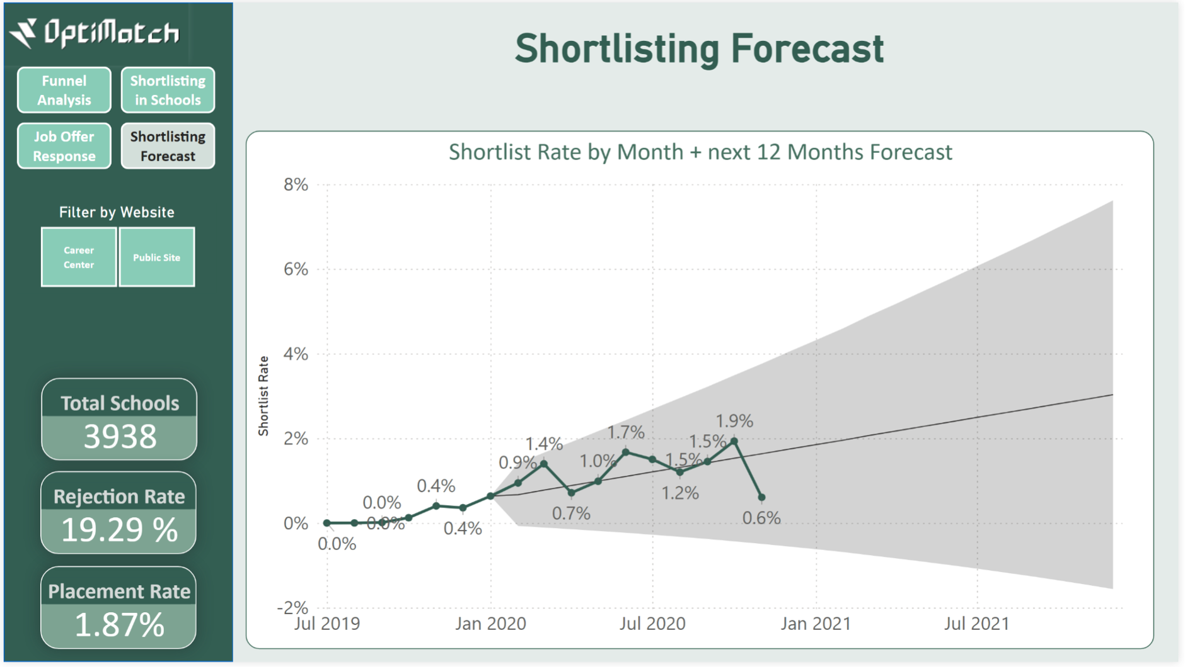

Slide 11



RECOMMENDATION
Shortlisting Process Optimization:
The Impact of Having a Career Center:
Profile Completeness Impact:
We suggest extending the response window for students from 3 days to 7 days or enhancing communication by diversifying notification channels to reach students more effectively.
Encouraging schools to establish career centers can significantly impact job placement outcomes
Encouraging students to complete their profiles and upload resumes by offering free resume templates tailored to different industries and career paths.

Slide 12



THANK YOU
Shatha Althbiti
Mosab Alsagabi
Norah Alsomali
Nujud Albaqshi

